Slide 1
1010043316
Analysis and Design of Algorithms
Unit 4: EXPLORING GRAPHS
SEMESTER: 5
PREPARED BY:

Slide 2
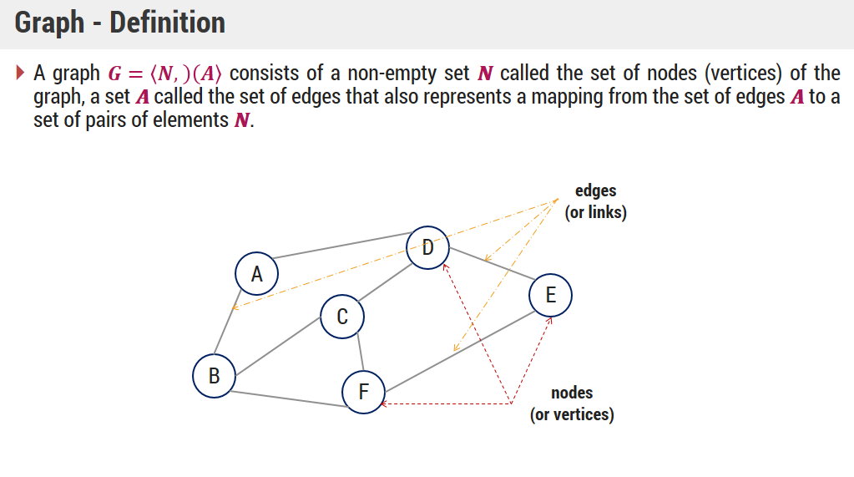
INTRODUCTION TO GRAPH

Slide 3
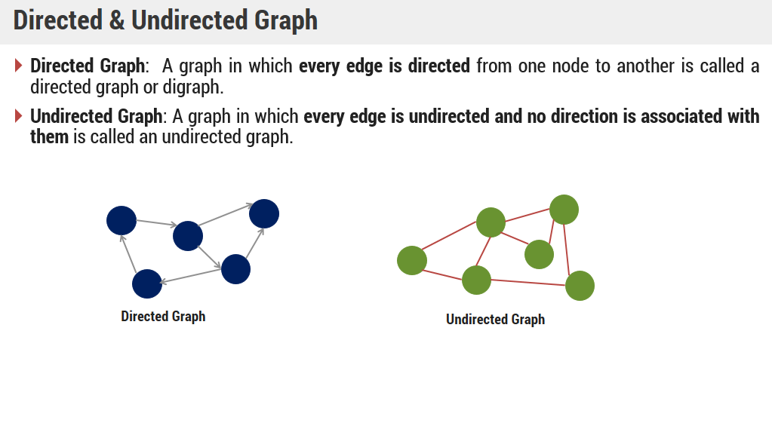

Slide 4
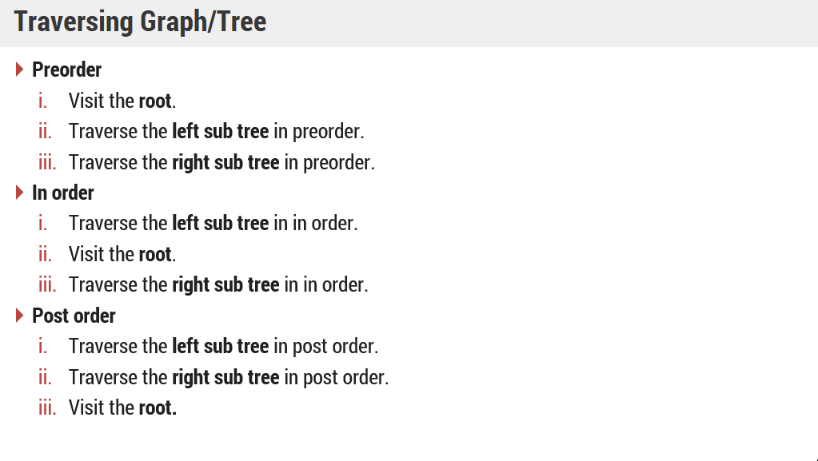
TRAVERSING GRAPHS

Slide 5
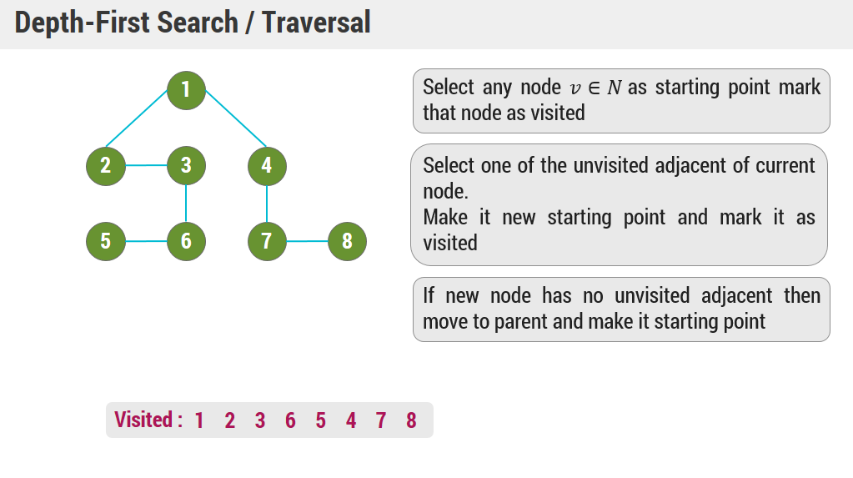

Slide 6
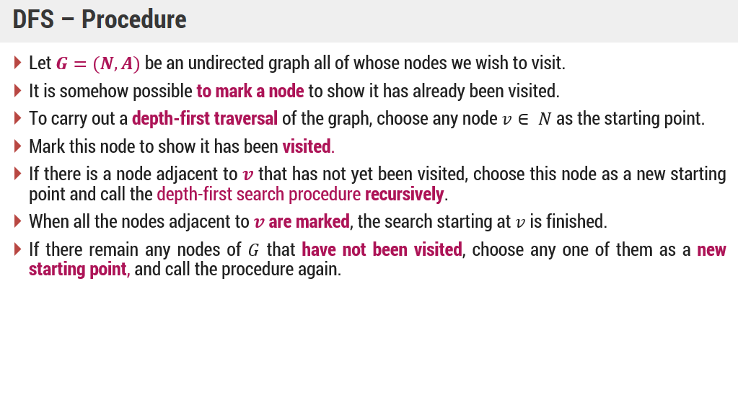

Slide 7
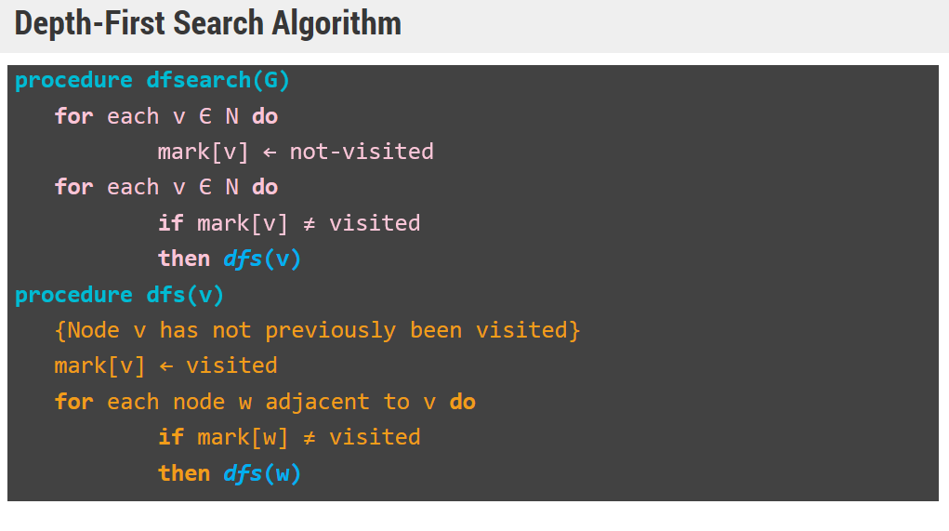

Slide 8
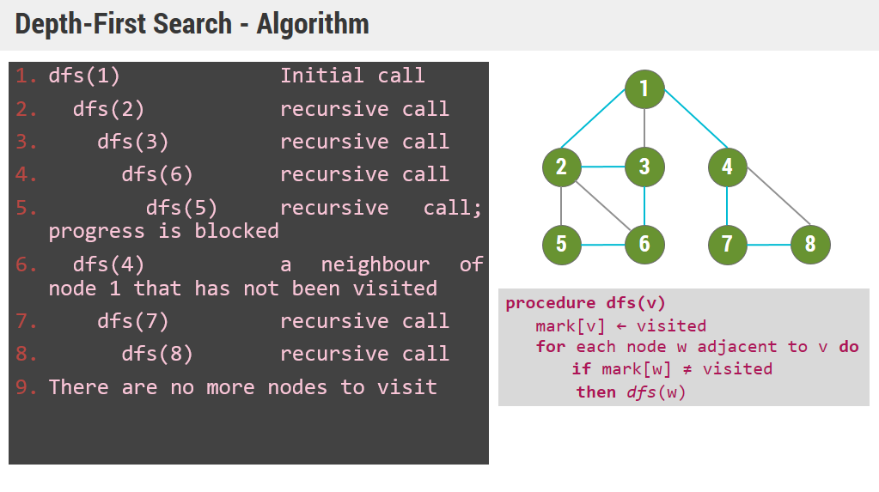

Slide 9
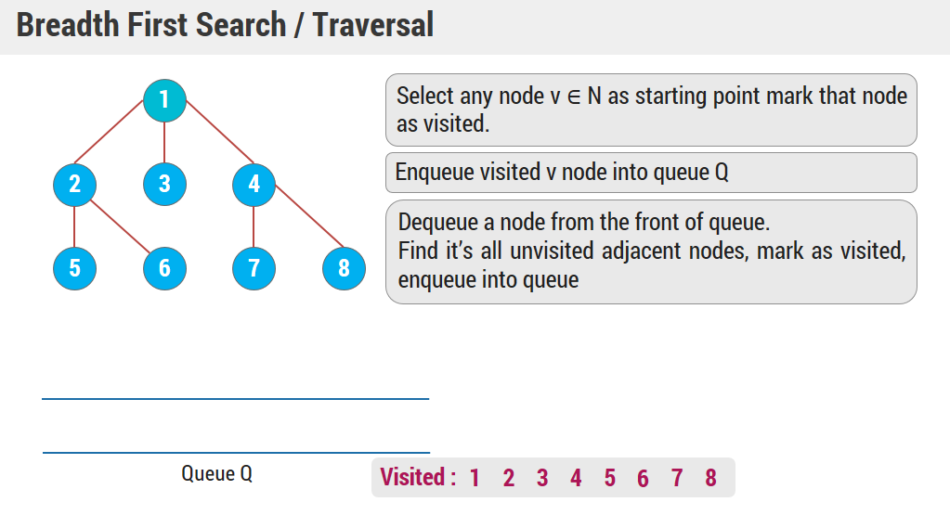

Slide 10
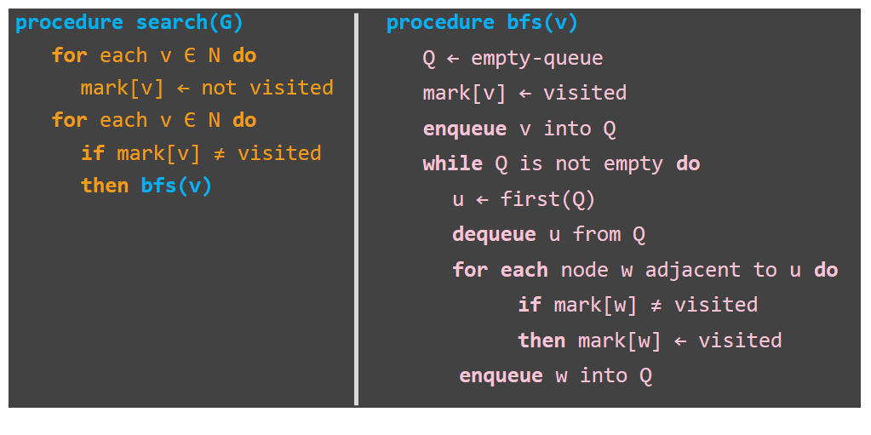
BREADTH FIRST SEARCH - ALGORITHM

Slide 11
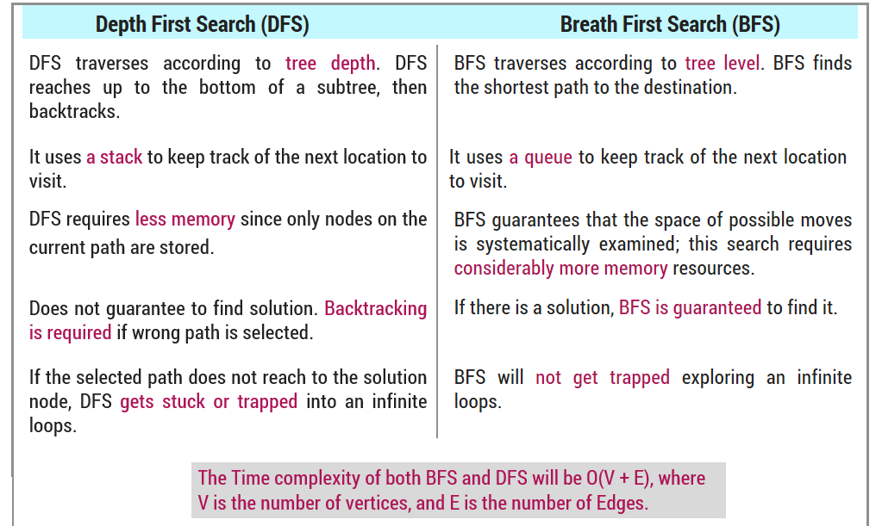
COMPARISON OF DFS AND BFS

Slide 12
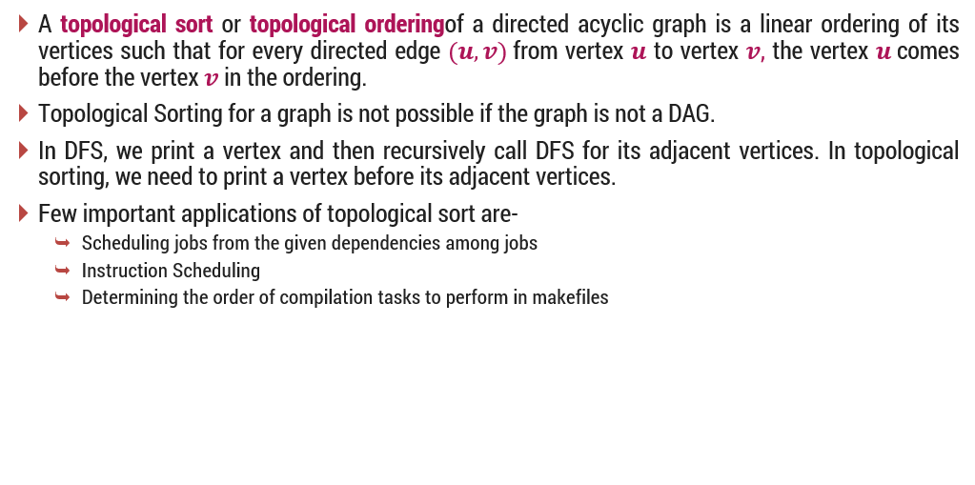
TOPOLOLOGICAL SORTING

Slide 13
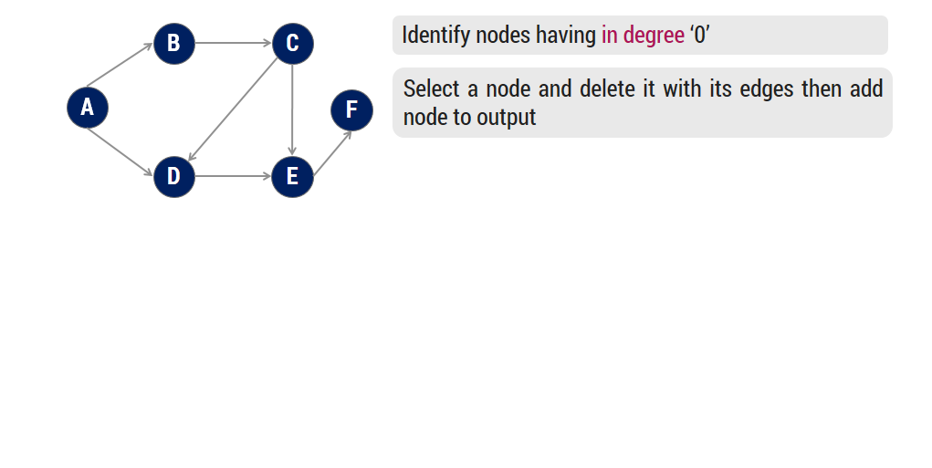
TOPOLOGICAL SORTING
- EXAMPLE 1

Slide 14
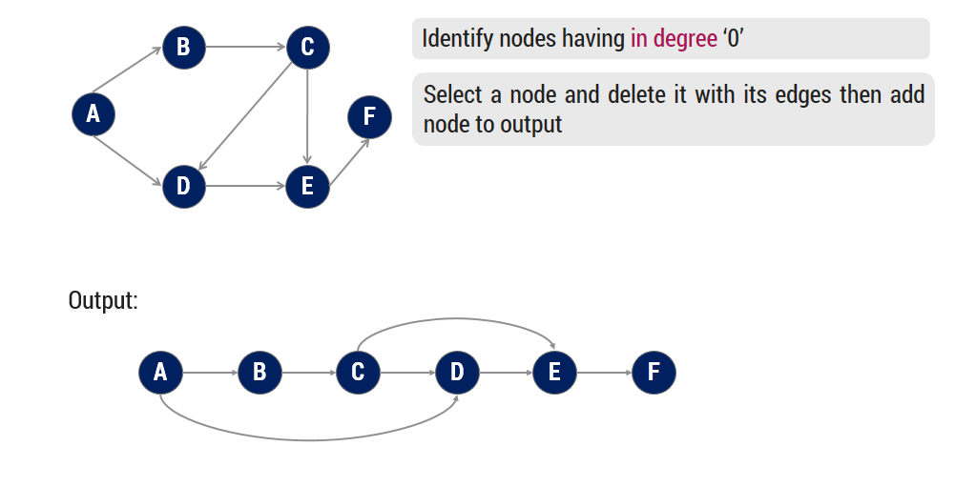
TOPOLOGICAL SORTING
- EXAMPLE 1

Slide 15
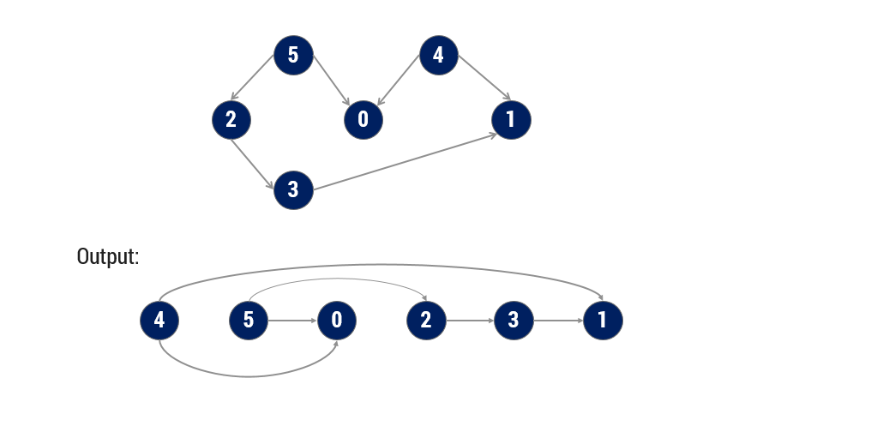
TOPOLOGICAL SORTING
- EXAMPLE 2

Slide 16
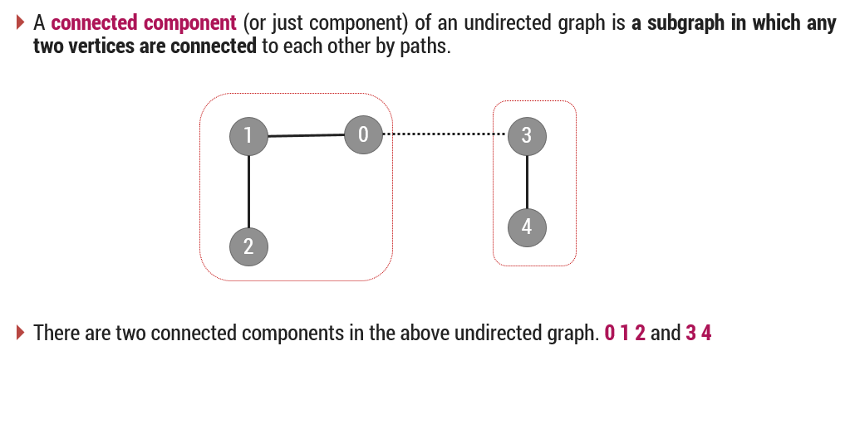
CONNECTED COMPONENTS

Slide 17
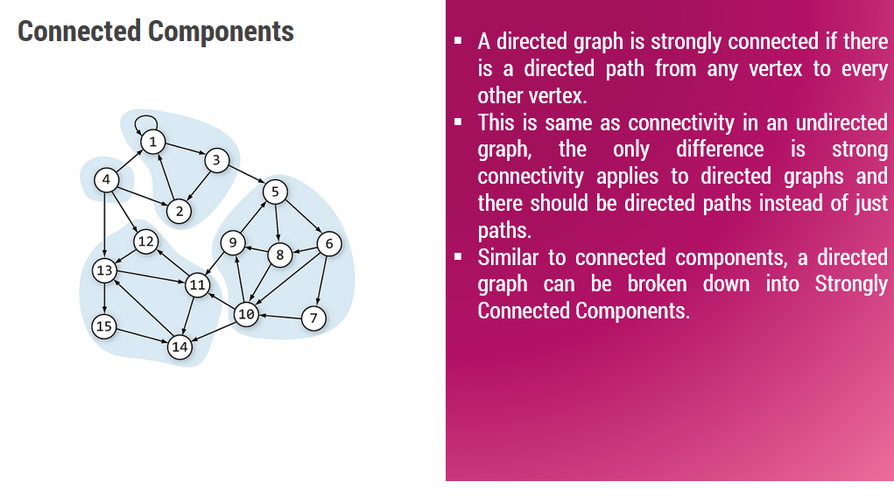

Slide 18
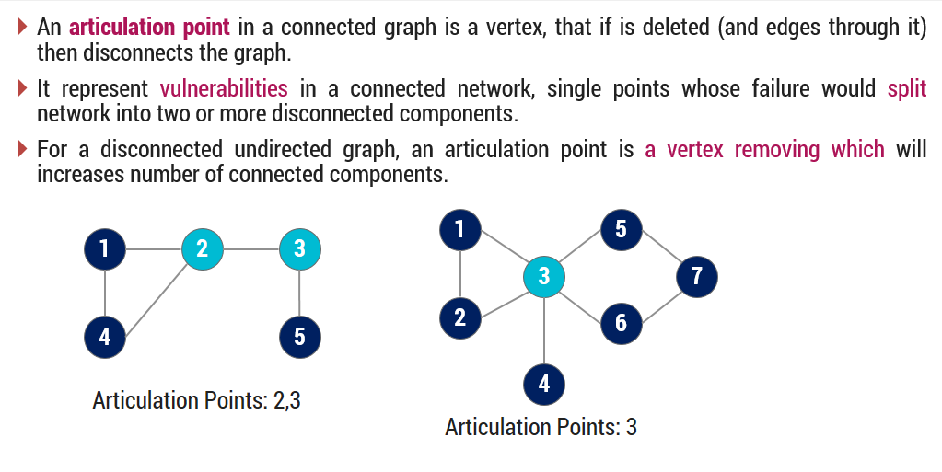
ARTICULATION POINT

Slide 19
THANK YOU

